Slide 1
Student Information System
Final Project Usability Testing
Chris DiMaio
Jishnu Menon
Ting Li Shen
Vivek Kumar

Slide 2
Evaluation Plan
Ask our participants four usability tasks that emulated problem areas that we found in SIS.
Two on Amazon.com and two on UML’s Blackboard (Explained later…).
Followed by a SUS survey
We wrap things up with a 5 question semi-structure interview.

Slide 3
Why Amazon and Blackboard for our potential problem solvers?
We thought it was unlikely that we could find a site that had all the functions commonly used on SIS that all our participants had access to.
Well also thought some of the tasks were generic and in common use across the internet.

Slide 4
Usability tasks
Amazon
Find bill/receipt (*Let user opt out of this for privacy reasons see 1a instead).
1a Find and pretend to purchase a text book Interaction Design 4th edition.
Login->Logout>Log back in.
Blackboard
Check calendar.
Check grades.

Slide 5
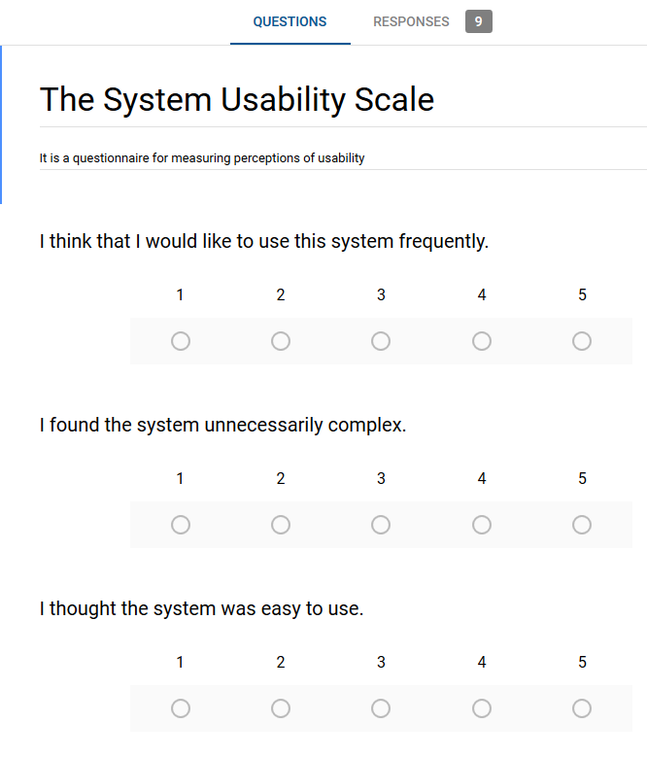

Slide 6
Interview questions
How was your overall experience completing the tasks?
Did you find interface to be interactive and enjoyable?
Which task took more time to complete and why?
Do you think there can be better interface to complete that task?
Is completing these tasks easier in comparison to completing the same tasks on SIS?

Slide 7
Usabilty Task Results
Amazon
We found that most people were quickly able to navigate Amazon to find receipts and to log and logout. There were ver few complaints. Three people opted to not use there personal orders when they did they found it simple to order an item.
Blackboard
People found Blackboard less intuitive but still with a little looking around were able to find both their grades and the calendar with relative easy.

Slide 8
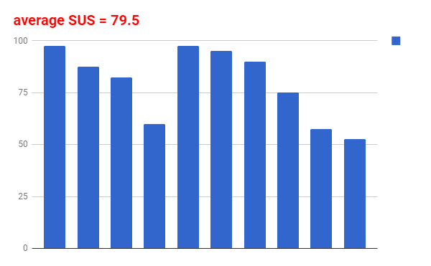
SUS Survey Results
Our SUS score is 79.5(B-). Therefore it is above a 68 considered average.

Slide 9
Interview Results
How was your overall experience completing the tasks?
Unanimous. Everyone found these easy to complete.
Did you find interface to be interactive and enjoyable?
Unanimous again for Amazon but some found Blackboard to give them some trouble
Which task took more time to complete and why?
Results were inconclusive but seemed to lean towards nothing taking very long.
Do you think there can be better interface to complete that task?
No suggestions or very minor suggests
Is completing these tasks easier in comparison to completing the same tasks on SIS?
Most people found these tasks easier to complete with some saying maybe.

Slide 10
Conclusion
We found that most people were relatively familar with these tasks and were able to complete then in minimal time.
We comtribute this to the interfaces following common placement and label conventions. For instance most websites tend to put the logout/in options in the same location and most tend to put important options in the top right hand side of the screen.
They also use short simple names like and icons/images the symbolize what the options are.
These common conventions and people’s familiarities with these sites and site like them made navigating the sites easy for a wide range of partiipants.

